Slide 1
Leftovers Locator

Slide 2
Problem Statement
• Large amounts of food wasted in weddings & events
• Orphanages & shelters face food shortages
• No real-time public platform to connect both
• No system to track, book & deliver leftover food

Slide 3

Proposed Solution
• Real-time geo-based web platform
• Hosts upload leftover food details
• NGOs can view & book nearby food
• Volunteers assist in delivery
• Automatic status updates

Slide 4
Core Features - Role Based Users
• Host (Event Organizer)
• NGO / Orphanage
• Volunteer
• Secure login & dashboard access

Slide 5
Host Can Post Food
• Food Name
• Quantity (Serves how many people)
• Veg / Non-Veg
• Auto Location (GPS)
• Expiry Time
• Contact Number
• Status: Available

Slide 6
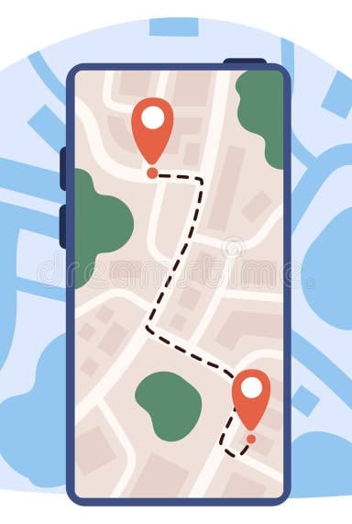
Geo-Location Integration
• Browser GPS integration
• Store latitude & longitude
• Display listings on live map
• Filter by nearby radius

Slide 7
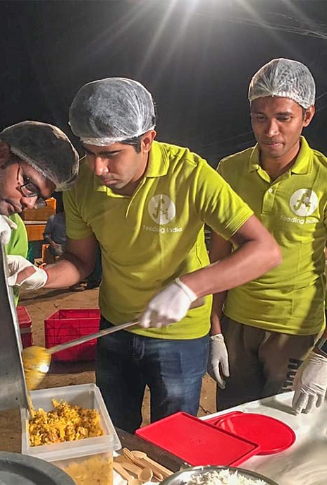
Live Food Feed
• Food title
• Serves count
• Distance from NGO
• Time remaining
• 'Book Now' button

Slide 8
Booking Logic
• NGO clicks 'Book'
• Status changes to 'Booked'
• bookedBy = NGO ID
• Hidden from available list
• Prevents duplicate booking

Slide 9
Volunteer Pickup (Optional MVP+)
• Host selects 'Need delivery help'
• Volunteer dashboard shows request
• Volunteer clicks 'Accept'
• volunteerId assigned
• Status updated to Completed after delivery

Slide 10
System Flow
1. Host logs in
2. Host uploads leftover food
3. Listing appears on map
4. NGO books food
5. Status changes to Booked
6. Volunteer accepts (optional)
7. Status updated to Completed

Slide 11
Impact & Benefits
• Reduces food wastage
• Supports orphanages & shelters
• Real-time coordination
• Encourages community volunteering
• Social impact & sustainability

Slide 12
Thank you
23B81A1203
23B81A1212
23B81A1224
23B81A1231
23B81A1253
23B81A1255

